Slide 1

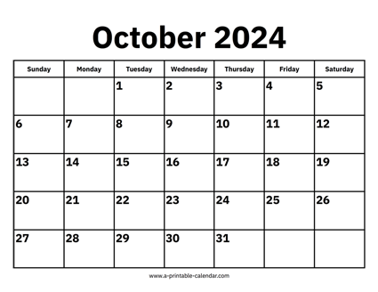

CS 310 : Scalable Software Architectures
Class session on Thursday, October 10th
Notes:
Focus this week:
Web services
Class sessions *are* being recorded this week
Will be available under Panopto on Canvas
Project 01 was due yesterday (Wednesday)
Can submit as late as Friday @ 11:59pm

Slide 2
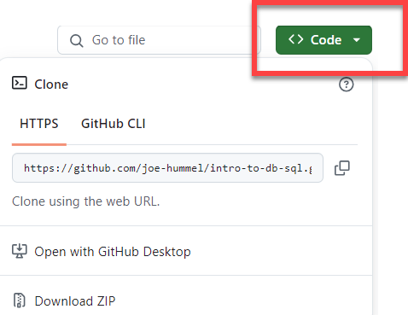
Getting the necessary software
Make sure Docker Desktop is running
Download files you need for today
https://github.com/joe-hummel/intro-web-services-server
https://github.com/joe-hummel/intro-web-services-client
You want to open 2 terminal windows, one based on server repo and one based on client repo:
Linux/Mac/Windows WSL:
Open terminal, navigate to repo folder
chmod 755 *.bash
./docker-build.bash
./docker-run.bash
Windows:
Open Powershell, navigate to repo folder
.\docker-build.bat
.\docker-run.bat

Slide 3
Common docker errors
"docker" command not found
Uninstall and reinstall Docker Desktop
When you try to build, you are not authorized
docker login -u docker-username
When you try to run, you get errors like "bash: $\r: command not found"
If you see the docker> prompt, type exit
((Get-Content .bashrc) -join "`n") + "`n" | Set-Content -NoNewLine .bashrc

Slide 4
Project 01 => Project 02

Slide 5
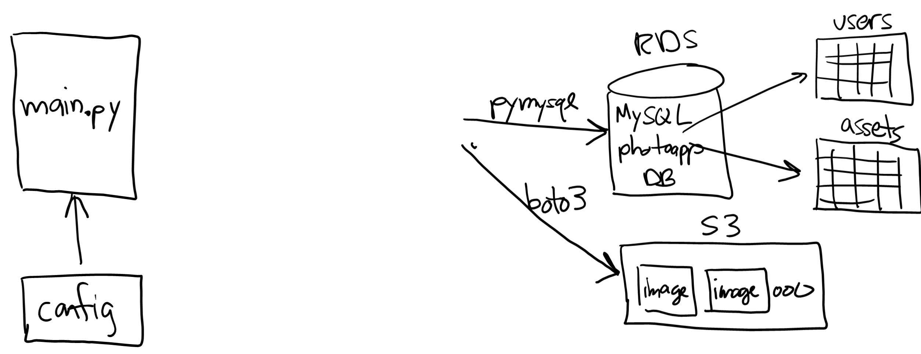






Project 01 => Project 02

Slide 6
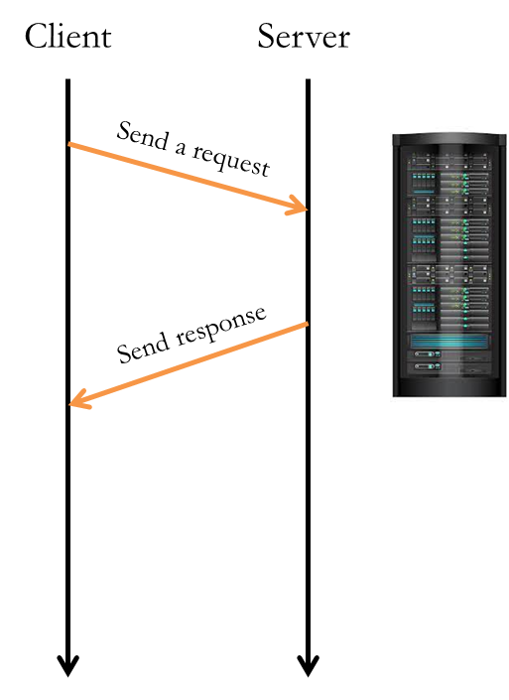
Goals for today
Web service examples
First a simple calculator service
Then a more realistic one based on movielens DB

Slide 7


Slide 8
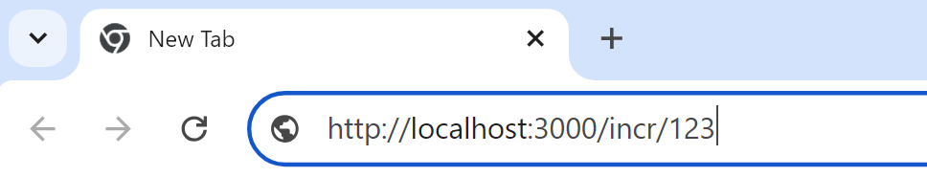


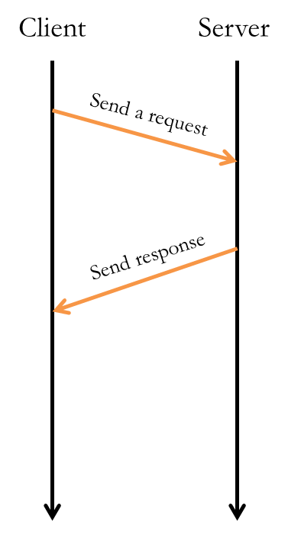
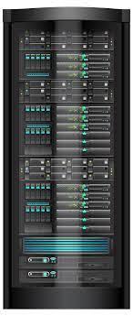
Example #1
A simple calculator web service:
const express = require('express');
const app = express();
// main():
app.listen(3000, () => {
console.log('**SERVER: running...');
});
// increment x:
app.get('/incr/:x', (req, res) => {
try {
console.log('**call to /incr');
let x = parseInt(req.params.x);
if (isNaN(x))
throw new Error('x not a number');
let y = x + 1;
res.send(y.toString());
return;
}
catch(err) {
res.status(400).send(err.message);
}
});
import requests
url = 'http://localhost:3000/'
x = input('Enter integer x> ')
url = url + 'incr/' + x
response = requests.get(url)
print(response.text)
Notes:
Exception handling allows us to control the status code, and the response string…

Slide 9
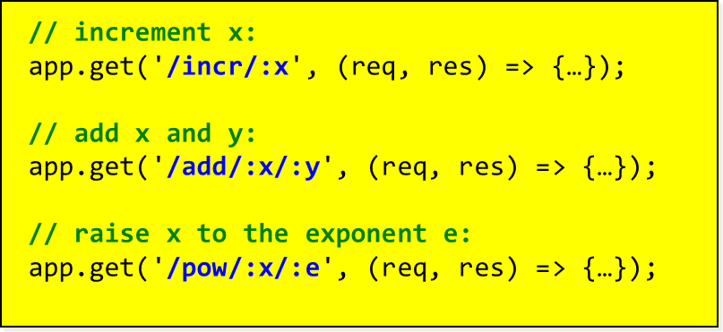
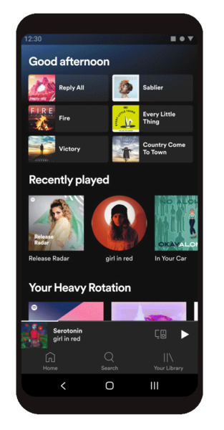


Simple SOA example
Simple calculator web service…

Slide 10
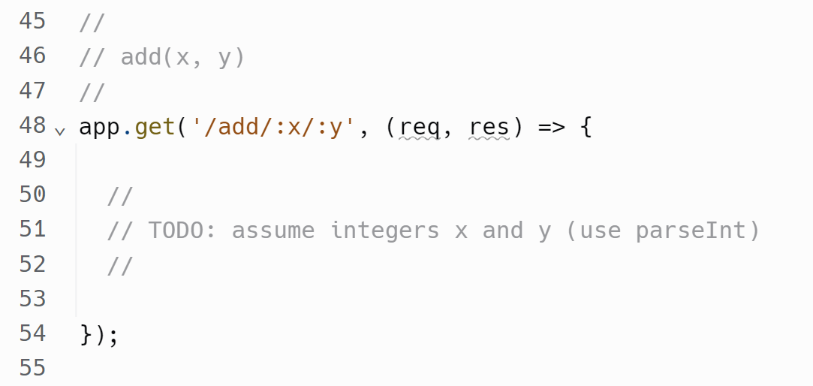
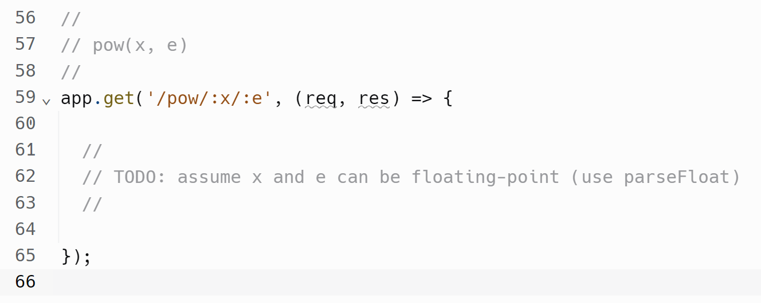
add(x, y) and pow(x, e)
Edit "server.js" and implement the two functions…
Notes:
app.get('/pow/:x/:e', (req, res) => {
let x = parseFloat(req.params.x);
let e = parseFloat(req.params.e);
let result = x ** e;
res.send(result.toString());
return;
});

Slide 12
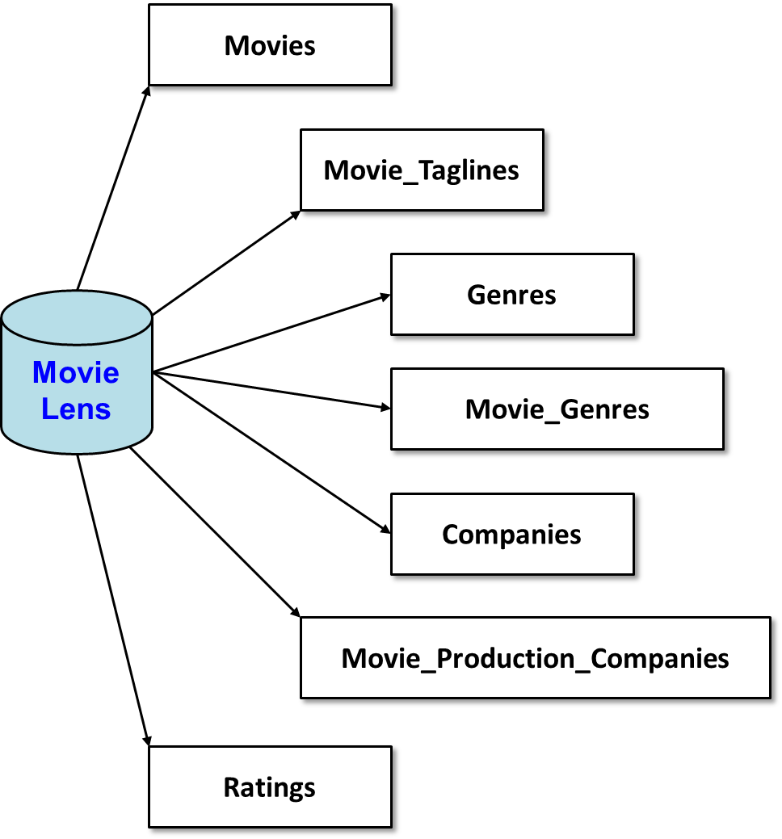
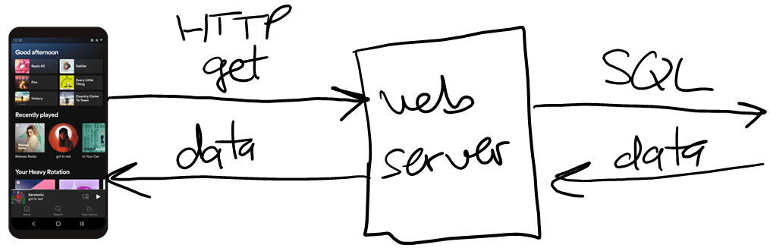
Example #2
Web service for the MovieLens database
Notes:
Make it clear that

Slide 13




MovieLens web service
Movie Lens
app.get('/movies', (req, res) => {…});
app.get('/movies/top10', (req, res) => {…});
// top N with at least M reviews (defaults to N=10, M=100):
app.get('/movies/topNwithM', (req, res) => {…});
// top N with at least M reviews, in given genre:
app.get('/movies/topNwithM/:genre', (req, res) => {…});
.
.
.
Notes:
Make it clear that

Slide 14
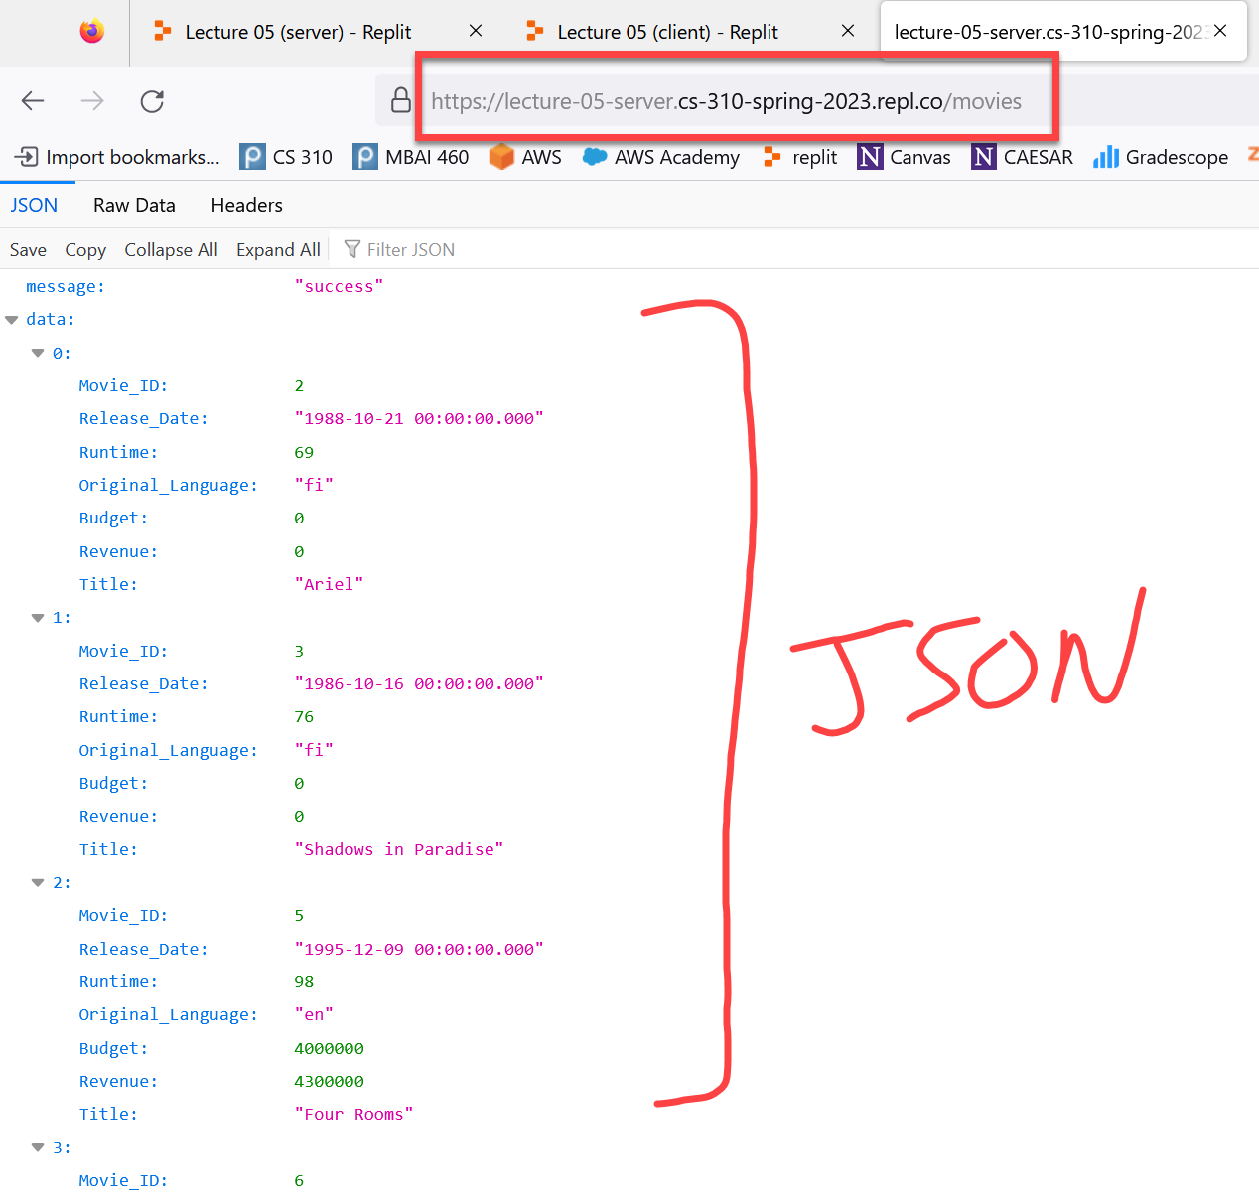
Demo using browser as client
Notes:
Start replit server…

Slide 15
/movies
//
// Retrieve all movies in the database:
//
app.get('/movies', (req, res) => {
try {
console.log("**call to /movies");
let sql = "Select * From Movies Order By Movie_ID;";
let params = [];
// execute the SQL:
movielens.all(sql, params, (err, rows) => {
if (err) {
res.status(500).json( {"message": err.message, "data": []} );
return;
}
// send response in JSON format:
console.log("sending response");
res.json( {"message": "success", "data": rows} );
});
console.log("about to return");
return;
}
catch(err) { res.status(500).json({"message": err.message, "data": []}); }
});
Notes:
Don't point out the async nature just yet…

Slide 16
/movies/:id
Let's write a function to retrieve a movie by id:
Edit "server2.js", add to bottom…
Return the data as a dictionary in JSON format…
//
// Retrieve the specified movie based on movie id:
//
app.get('/movies/:id', (req, res) => {
try {
console.log("**call to /movies/:id");
let id = ???;
let sql = "Select * from ...";
let params = [id];
// execute the SQL and return the result (or an error):
movielens.get(???
});
return;
}
catch(err) { res.status(500).json({ "message": err.message, "data": {} }); }
});

Slide 17
Client testing
Use a browser to test…
Test a movie id that exists: 862 or 603
Test a movie id that doesn't exist: 123456789
Status code should be 200 in both cases --- they both executed successfully, one just didn't find a movie
If the movie exists, data be { "Movie_ID":…, … }
If the movie doesn't exists, change msg, data should be { }
[ or should we return status code 400 if movie doesn't exist? ]

Slide 18
Solution /movies/:id
//
// Retrieve the specified movie based on movie id:
//
app.get('/movies/:id', (req, res) => {
try {
console.log("**call to /movies/:id");
id = req.params.id;
let sql = 'select * from movies where movie_id = ?;'
let params = [id];
// execute the SQL and return the result (or an error):
movielens.get(sql, params, (err, row) => {
if (err) {
res.status(500).json({ message: err.message, data: {} });
return;
}
if (row == undefined) { // no such movie:
res.json({ message: "no such movie", data: {} });
return;
}
res.json({ message: "success", data: row });
});
return;
}
catch(err) { res.status(500).json({ "message": err.message, "data": {} }); }
});

Slide 19
Client-side in Python
Call your function using Python client
Edit "client4.py"
import requests
baseurl = 'http://localhost:3000' ## no / at the end
id = input('enter a movie id (e.g. 862)> ')
url = baseurl + "/movies/" + id
response = requests.get(url)
# print status_code
# if status_code == 200:
# deserialize the response
# print the message
# print the data
{'message': …,
'data': … }
print(response.status_code)
if response.status_code == 200:
body = response.json()
message = body['message']
data = body['data']
print(message)
print(data)

Slide 20
That's it, thank you!

Slide 21
Movies
Movie_Taglines
Genres
Movie Lens
Movie_Genres
Companies
Movie_Production_Companies
Ratings

Slide 22
Movie_ID | Title | Release_Date | Runtime | Original_Language | Budget | Revenue
603 | The Matrix | 1999-03-30 00:00:00.000 | 136 | en | 63000000 | 463517383
862 | Toy Story | 1995-10-30 00:00:00.000 | 81 | en | 30000000 | 373554033
Movies
Movie_ID | Tagline
603 | Welcome to the Real World.
605 | Everything that has a beginning has an end.
Movie_Taglines
Movie Lens
Ratings
Movie_ID | Rating
605 | 8
603 | 6
605 | 10
605 | 6

Slide 23
Company_ID | Company_Name
1885 | Silver Pictures
6194 | Warner Bros.
Movie_ID | Company_ID
603 | 1885
603 | 6194
862 | 3
Companies
Movie_Production_Companies
Movie_ID | Genre_ID
862 | 16
862 | 35
603 | 28
603 | 878
Movie Lens
Movie_Genres
Genres
Genre_ID | Genre_Name
28 | Action
878 | Science Fiction
16 | Animation
35 | Comedy

